Slide 1
Method Overriding
In inheritance, all members available in the parent class are by default available in the child class.
If the child class is not satisfied with how the parent class is implemented, then the child class is allowed to redefine the parent’s methods by extending additional functions.
This concept is called method overriding.
When a child class method has the same name, same parameters, and same return type as a method in its superclass, then the method in the child is said to override the method in the parent class.

Slide 2
class Vehicle:
def max_speed(self):
print("max speed is 100 Km/Hour")
class Car(Vehicle):
# overridden the implementation of Vehicle class
def max_speed(self):
print("max speed is 200 Km/Hour")
# Creating object of Car class
car = Car()
car.max_speed()
The class Car extends from the class Vehicle so, all properties of the parent class are available in the child class.
In addition to that, the child class redefined the method max_speed().

Slide 3
Method Resolution Order in Python
In Python, Method Resolution Order(MRO) is the order by which Python looks for a method or attribute.
First, the method or attribute is searched within a class, and then it follows the order we specified while inheriting.
This order is also called the Linearization of a class, and a set of rules is called MRO (Method Resolution Order).
The MRO plays an essential role in multiple inheritances as a single method may be found in multiple parent classes.

Slide 4
In multiple inheritance, the following search order is followed.
  First, it searches in the current parent class if not available, then searches in the parents class specified while inheriting (that is left to right.)
  We can get the MRO of a class. For this purpose, we can use either the mro attribute or the mro() method.

Slide 5
Polymorphism in Python

Slide 6
The term Polymorphism comes from two greek words poly and morph.
Poly meaning - many, much, multi-, one or more
Morph meaning - shape, form or structure
Thus the collective term polymorphism means the state of existing in or assuming different forms.
When something exists in a state that has multiple forms we can say that it is ‘polymorphic’ in nature.

Slide 7
So what is polymorphism in OOP(Python)
Polymorphism in Python is the ability of an object to take many forms.
In simple terms, polymorphism allows us to perform the same action in many different ways.
For example, Mark acts as an employee when he is at the office. However, when he is at home, he acts like a husband Also, he represents himself differently in different places.
Therefore, the same person takes different forms as per the situation.
In polymorphism, a method can process objects differently depending on the class type or data type

Slide 8
Polymorphism in Built-in function len()
The built-in function len() calculates the length of an object depending upon its type.
If an object is a string, it returns the count of characters,
If an object is a list, it returns the count of items in the list.
The len() method treats an object as per its class type.
students = ['Emma', 'Jessa', 'Kelly']
school = 'ABC School'
# calculate count
print(len(students))
print(len(school))

Slide 9
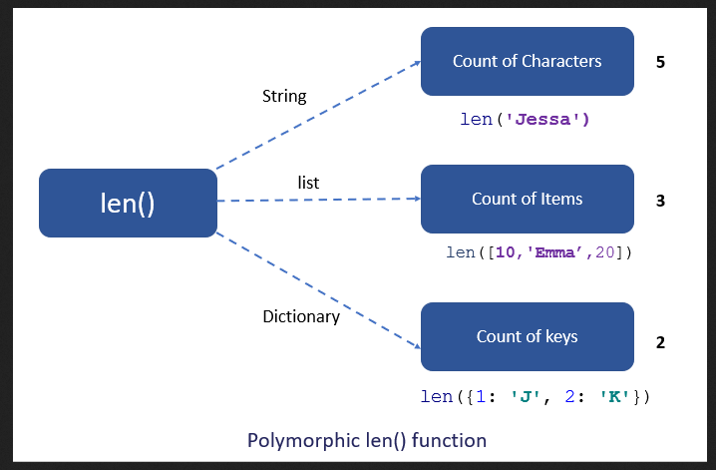

Slide 10
Polymorphism With Inheritance
Polymorphism is mainly used with inheritance. In inheritance, child class inherits the attributes and methods of a parent class.
Using method overriding polymorphism allows us to defines methods in the child class that have the same name as the methods in the parent class.
This process of re-implementing the inherited method in the child class is known as Method Overriding.

Slide 11
Advantage of method overriding
It is effective when we want to extend the functionality by altering the inherited method. Or the method inherited from the parent class doesn’t fulfill the need of a child class, so we need to re-implement the same method in the child class in a different way.
Method overriding is useful when a parent class has multiple child classes, and one of that child class wants to redefine the method. The other child classes can use the parent class method. Due to this, we don’t need to modification the parent class code

Slide 12
In polymorphism, Python first checks the object’s class type and executes the appropriate method when we call the method.
For example, we have a vehicle class as a parent and a ‘Car’ and ‘Truck’ as its sub-class.
But each vehicle can have a different seating capacity, speed, etc., so we can have the same instance method name in each class but with a different implementation.

Slide 13
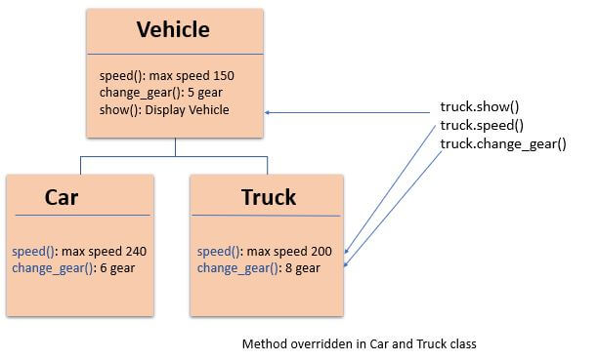

Slide 14
Polymorphism In Class methods
Polymorphism with class methods is useful when we group different objects having the same method.
we can add them to a list or a tuple, and we don’t need to check the object type before calling their methods.
Instead, Python will check object type at runtime and call the correct method. Thus, we can call the methods without being concerned about which class type each object is. We assume that these methods exist in each class.

Slide 15
Example
Let’s design a different class in the same way by adding the same methods in two or more classes.
Next, create an object of each class
Next, add all objects in a tuple.
In the end, iterate the tuple using a for loop and call methods of a object without checking its class.

